Slide 1
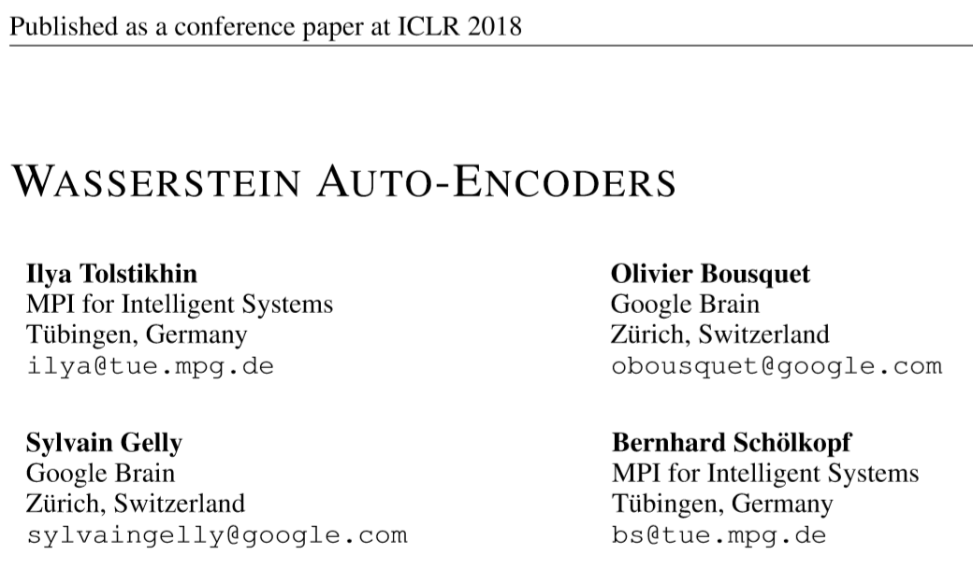
Wasserstein Auto-Encoders
Reporter: Li Qingtao

Slide 2
Outline
Wasserstein Auto-Encoder: a new family of algorithms for building generative models.
Variational Auto-Encoder: a brief introduction
Motivation: Optimal Transport cost (Wasserstein distance)
+ different discrepancy penalty
compared to VAE
Algorithm: WAE-GAN and WAE-MMD
Experiments: with dataset MNIST and CelebA

Slide 3
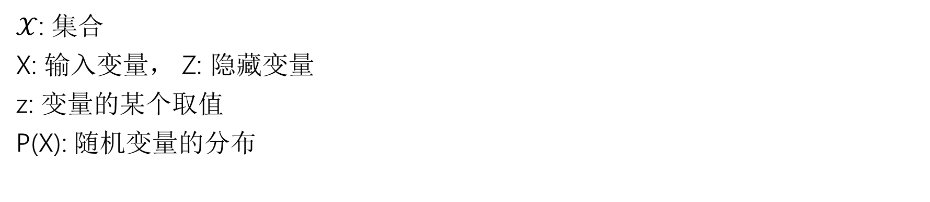
Symbols
$𝒳$: 集合
X: 输入变量， Z: 隐藏变量
z: 变量的某个取值
P(X): 随机变量的分布

Slide 4
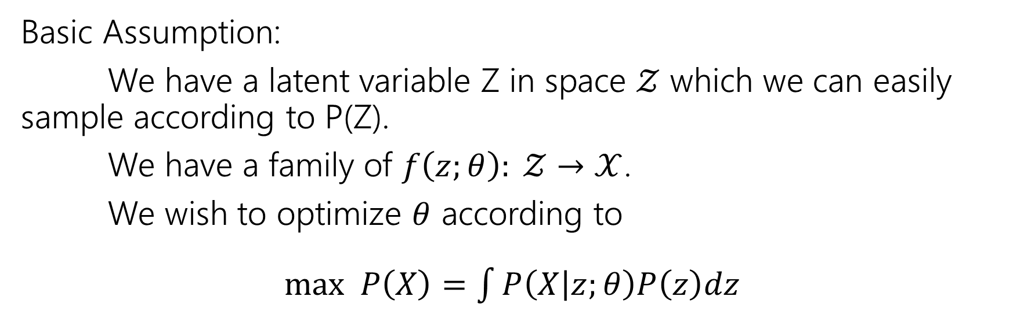
Variational Auto-Encoder
Basic Assumption:
We have a latent variable Z in space $𝒵$ which we can easily sample according to P(Z).
We have a family of $f\left(z;θ\right): 𝒵→𝒳$.
We wish to optimize $θ$ according to
$max P\left(X\right)=\int{P\left(X | z;θ\right)P\left(z\right)dz}$

Slide 5
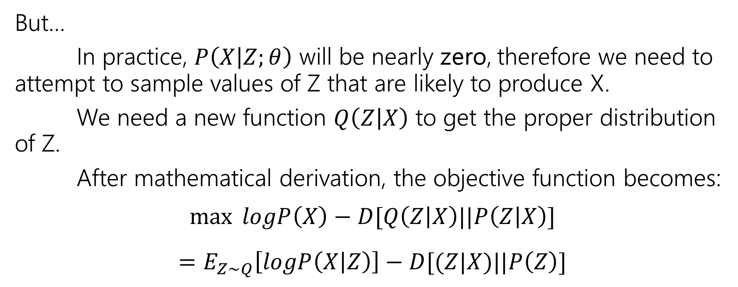
Variational Auto-Encoder
But…
In practice, $P\left(X | Z;θ\right)$ will be nearly zero, therefore we need to attempt to sample values of Z that are likely to produce X.
We need a new function $Q\left(Z | X\right)$ to get the proper distribution of Z.
After mathematical derivation, the objective function becomes:
$$\max{logP\left(X\right)−D[Q\left(Z | X\right)||P\left(Z | X\right)]}$$
$$=E_{Z\sim Q}\left[logP\left(X | Z\right)\right]−D[(Z|X)||P\left(Z\right)]$$

Slide 6
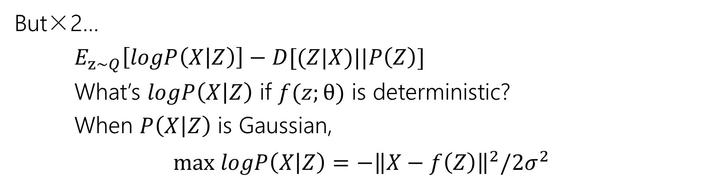
Variational Auto-Encoder
But×2…
$E_{z\sim Q}\left[logP\left(X | Z\right)\right]−D[(Z|X)||P\left(Z\right)]$
What’s $logP\left(X | Z\right)$ if $f(z;θ)$ is deterministic?
When $P\left(X | Z\right)$ is Gaussian,
$$max logP\left(X | Z\right)=−{\left\|X−f\left(Z\right)\right\|}^{2}/2σ^{2}$$

Slide 7
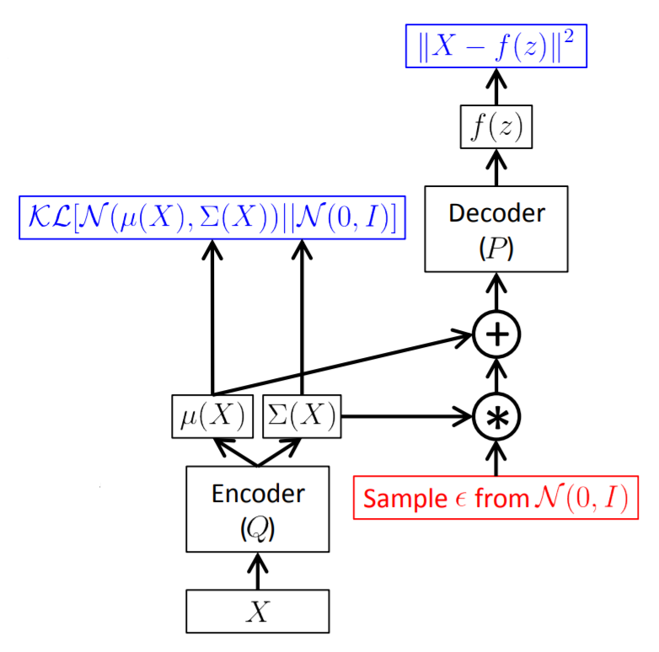
Variational Auto-Encoder
KL-divergence has shortcomings
decoder must be non-deterministic
code
graph from Carl Doersch, Tutorial on Variational Autoencoders

Slide 8
Variational Auto-Encoder
Optimal Transport cost (Wasserstein distance)
deterministic encoder/decoder
code
different discrepancy penalty
graph from Carl Doersch, Tutorial on Variational Autoencoders

Slide 9
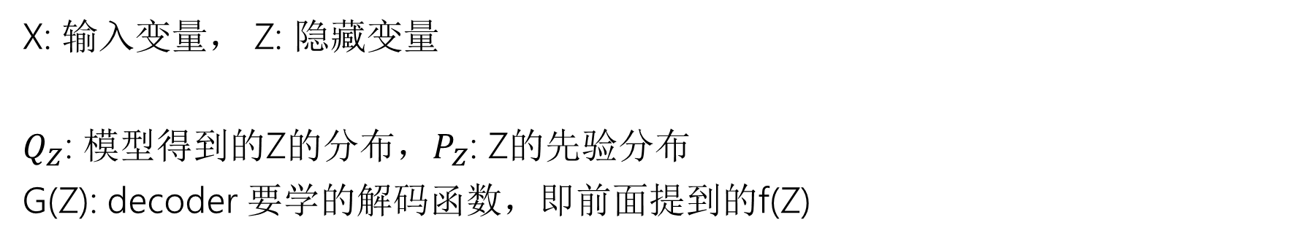
Symbols
X: 输入变量， Z: 隐藏变量
$Q_{Z}$: 模型得到的Z的分布，$P_{Z}$: Z的先验分布
G(Z): decoder 要学的解码函数，即前面提到的f(Z)

Slide 10
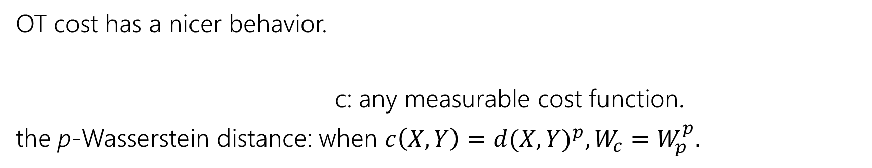
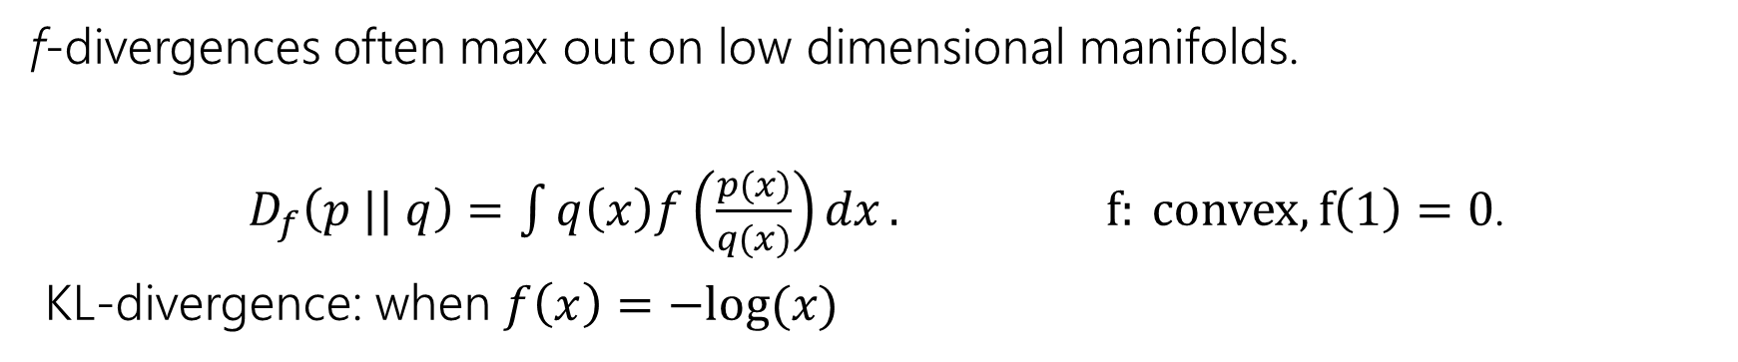
Motivation: Optimal Transport (OT)
Advantage over KL-divergence
f-divergences often max out on low dimensional manifolds.
$D_{f}\left(p || q\right)=\int{q\left(x\right)f\left(\frac{p(x)}{q(x)}\right)dx}. f: convex, f\left(1\right)=0$.
KL-divergence: when $f\left(x\right)=−log⁡(x)$
当数据分布在低维流型上时，使用f-散度很容易出现梯度为0的情形。
OT cost has a nicer behavior.
c: any measurable cost function.
the p-Wasserstein distance: when $c\left(X, Y\right)={d(X, Y)}^{p}, W_{c}=W_{p}^{p}.$

Slide 11
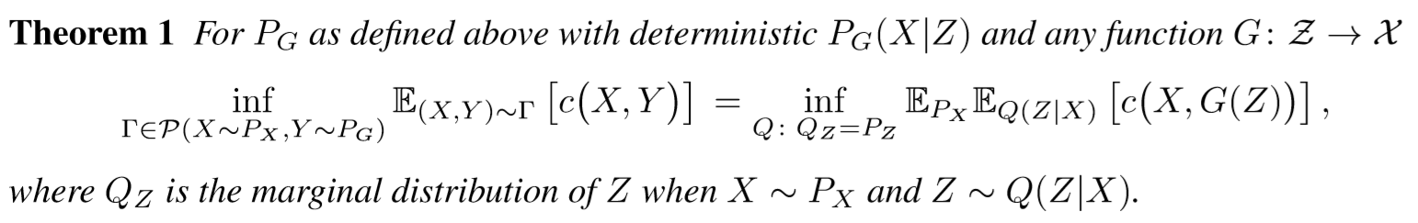

Motivation: Optimal Transport (OT)
Optimize over the distribution
When $P_{G}\left(X | Z\right)$ is a given map $G: Z→X$,
optimizing $W_{c}(P_{X},P_{G})$ is optimizing $Q\left(Z | X\right)$ instead of optimizing all $(x, y)$ pairs.

Slide 12
Motivation: WAE
Advantage over VAE
reconstruction cost
discrepancy penalty
discrepancy penalty
reconstruction cost

Slide 13
Motivation: WAE
Advantage over VAE
can be deterministic or random
optimize over the distribution
optimize over every single data Q(Z | X)
must be non-deterministic

Slide 14
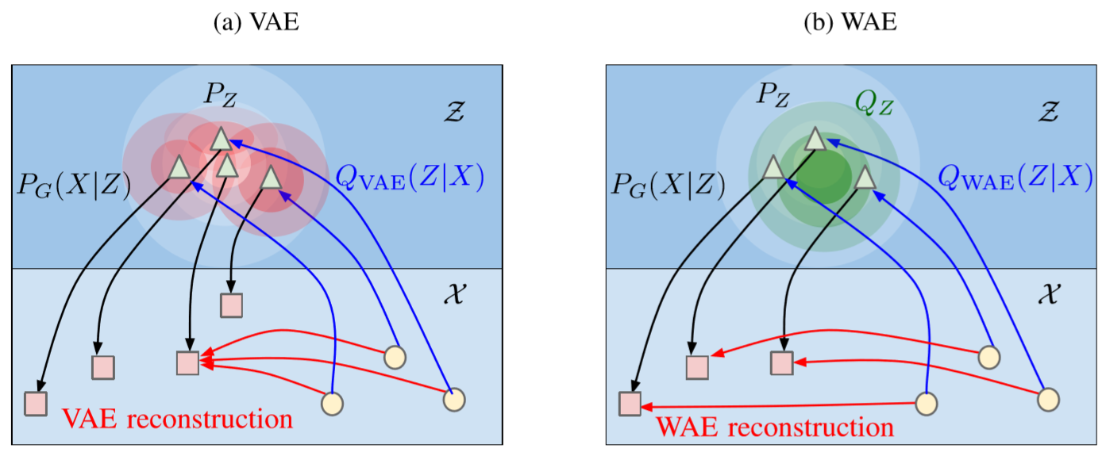
Motivation

Slide 15

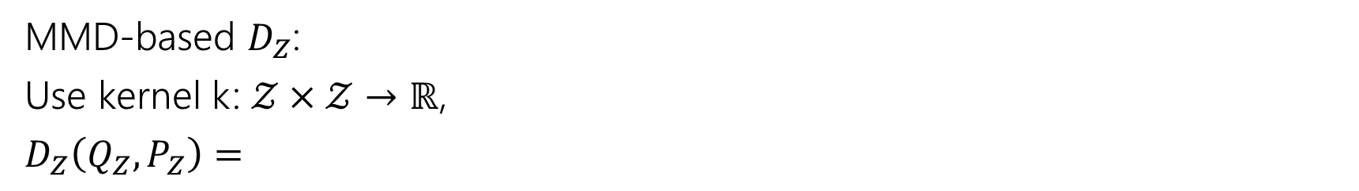
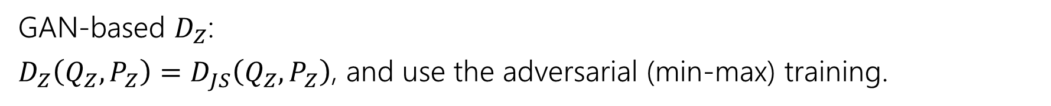
Motivation: different discrepancy penalty
GAN-based $D_{Z}$:
$D_{Z}\left(Q_{Z},P_{Z}\right)=D_{JS}\left(Q_{Z},P_{Z}\right)$, and use the adversarial (min-max) training.
MMD-based $D_{Z}$:
Use kernel k: $𝒵×𝒵→ℝ$,
$D_{Z}\left(Q_{Z},P_{Z}\right)=$
Notes:
RKHS，再生核希尔伯特空间，是由Z到R的映射构成的空间。

Slide 16
Algorithm
Notes:
RKHS，再生核希尔伯特空间，是由Z到R的映射构成的空间。

Slide 17
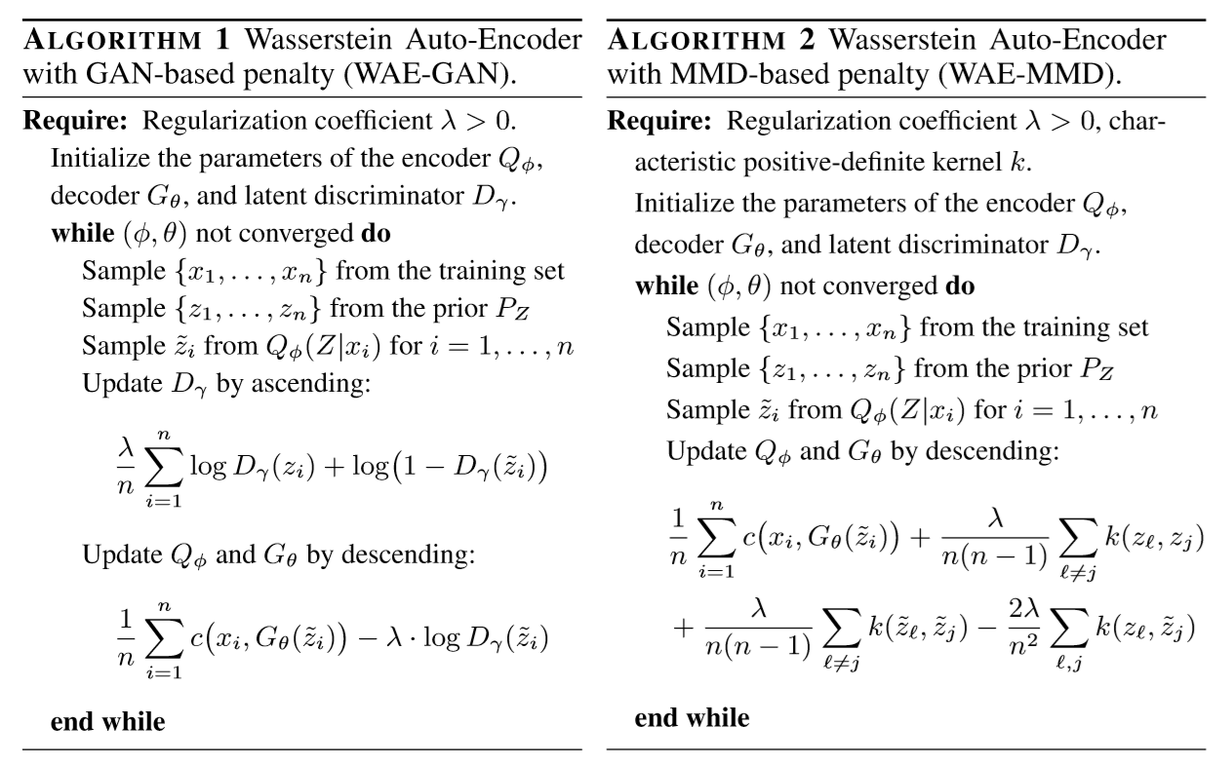

Slide 18
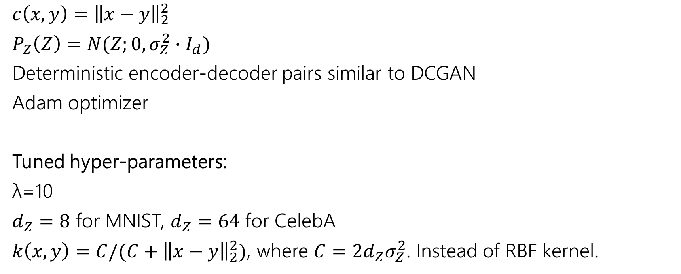
Experiments-settings
$c\left(x,y\right)={\left\|x−y\right\|}_{2}^{2}$
$P_{Z}\left(Z\right)=N(Z;0,σ_{Z}^{2}∙I_{d})$
Deterministic encoder-decoder pairs similar to DCGAN
Adam optimizer
Tuned hyper-parameters:
λ=10
$d_{Z}=8$ for MNIST, $d_{Z}=64$ for CelebA
$k\left(x,y\right)=C/(C+{\left\|x−y\right\|}_{2}^{2})$, where $C=2d_{Z}σ_{Z}^{2}$. Instead of RBF kernel.
Notes:
RKHS，再生核希尔伯特空间，是由Z到R的映射构成的空间。

Slide 19
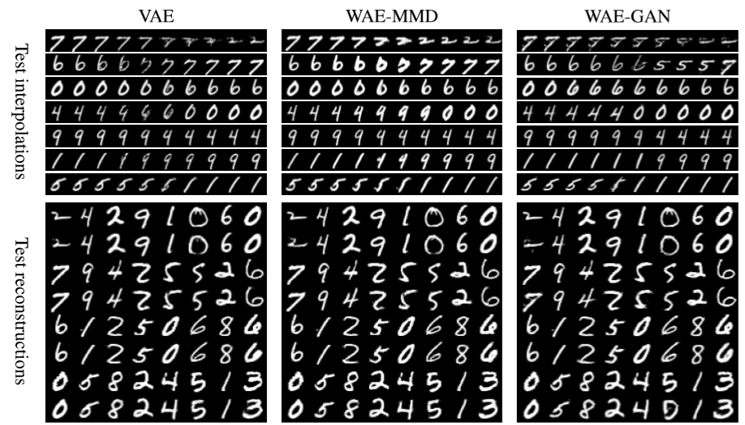
Experiments-MNIST
Notes:
RKHS，再生核希尔伯特空间，是由Z到R的映射构成的空间。

Slide 20
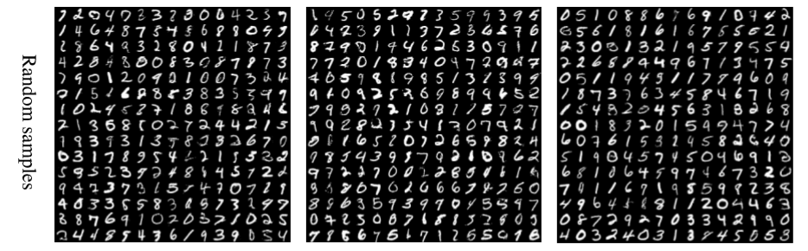
Experiments-MNIST
VAE
WAE-MMD
WAE-GAN
Notes:
RKHS，再生核希尔伯特空间，是由Z到R的映射构成的空间。

Slide 21
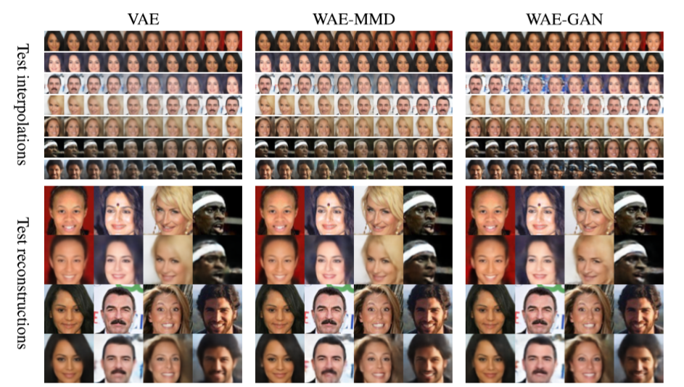
Experiments-CelebA

Slide 22
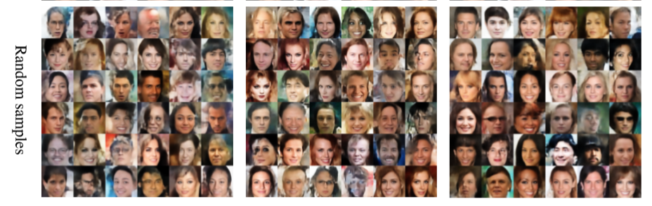
Experiments-CelebA
VAE
WAE-MMD
WAE-GAN
Notes:
RKHS，再生核希尔伯特空间，是由Z到R的映射构成的空间。

Slide 23
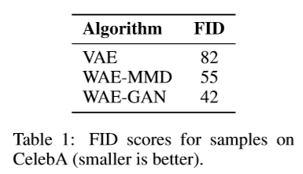
Experiments-CelebA
FID = Frechet Inception Distance.
它来自于一篇长达38页的NIPS 2017 paper.
Notes:
RKHS，再生核希尔伯特空间，是由Z到R的映射构成的空间。

Slide 24
Conclusion
Images from WAE models are of better quality, without compromising the stability of training and the quality of reconstruction.
In some cases, WAE-GAN seems lead to a better matching and generates better images.
WAE-GAN is highly unstable, while WAE-MMD is stable.
Notes:
RKHS，再生核希尔伯特空间，是由Z到R的映射构成的空间。

Slide 25
Thanks for Listening!
Any Questions?

